Slide 1


Air Quality Forecasting using ML
<Mohammed Fahim R>
<Hameed Vajir Terdale>
<Mentor Name : Sanjay S C>
College Name - K S Institute of Technology
Notes:
Let's delve deeper into the exciting world of sustainability and AI.
In this chapter, we'll explore how artificial intelligence can be a powerful tool for addressing environmental challenges and promoting sustainable practices. We'll discuss specific applications of AI in various sectors and analyze its potential to drive positive change.
Get ready to discover the innovative ways AI is contributing to a more sustainable future!

Slide 2

Project Objectives
Problem Statement
Project Overview – Introduction
End Users
Wow Factor in Project
Modelling/Block Diagram/Flow of Project
Result/outcomes
Conclusion
Future Perspective
Notes:
Let's outline what you'll learn in this presentation.
By the end, you'll be able to:
Understand how AI helps solve problems like climate change, resource depletion, and biodiversity loss.
Identify key AI uses in energy efficiency, waste management, and climate change.
Analyze AI's role in sustainable agriculture and cities.
Evaluate AI's use in environmental monitoring using satellites, real-time data, and predictions.
Apply AI strategies in logistics and transportation to make them more sustainable.
Get ready to discover how AI can help create a greener future!

Slide 3
Problem Statement
Air pollution has become one of the most serious environmental challenges in India, with rising PM2.5 levels posing significant health risks. However, the public often lacks access to reliable short-term forecasts that can help them plan and protect themselves from poor air quality. This project aims to build a data-driven system that predicts future PM2.5(Particulate Matter 2.5) concentrations and corresponding Air Quality Index (AQI) for major Indian cities using Machine Learning (Prophet model). The goal is to provide users with an easy-to-use interactive dashboard that displays current and forecasted air quality trends to support awareness and preventive action.
Notes:
Sustainability and AI
Sustainability is important because it helps meet our needs now and in the future. It includes protecting the environment, reducing pollution, and improving economic and social well-being.
AI can help us achieve sustainability. AI can process data, make predictions, and optimize systems to solve problems like resource management, environmental conservation, and energy efficiency.
Examples:
Smart grids: Reduce energy consumption.
Agriculture: Optimize water and fertilizer use.
Biodiversity: Monitor wildlife to protect biodiversity.
AI is a powerful tool for creating a more sustainable future.

Slide 4
Project Overview - Introduction
This project predicts PM2.5 concentration and Air Quality Index (AQI) for major Indian cities using the Prophet Machine Learning model. It analyzes historical air quality data to forecast future pollution trends. The results are displayed on an interactive Streamlit dashboard, helping users and authorities monitor and plan actions to reduce pollution impact.
Notes:
Sustainability and AI
Sustainability is important because it helps meet our needs now and in the future. It includes protecting the environment, reducing pollution, and improving economic and social well-being.
AI can help us achieve sustainability. AI can process data, make predictions, and optimize systems to solve problems like resource management, environmental conservation, and energy efficiency.
Examples:
Smart grids: Reduce energy consumption.
Agriculture: Optimize water and fertilizer use.
Biodiversity: Monitor wildlife to protect biodiversity.
AI is a powerful tool for creating a more sustainable future.

Slide 5
End Users
General Public: To stay aware of air quality levels and plan outdoor activities safely.
Health Organizations: To issue health advisories and prepare for pollution-related cases.
Government & Policymakers: To monitor city pollution trends and plan environmental policies.
Researchers & Environmentalists: To study air pollution patterns and validate forecasting model
Notes:
Sustainability and AI
Sustainability is important because it helps meet our needs now and in the future. It includes protecting the environment, reducing pollution, and improving economic and social well-being.
AI can help us achieve sustainability. AI can process data, make predictions, and optimize systems to solve problems like resource management, environmental conservation, and energy efficiency.
Examples:
Smart grids: Reduce energy consumption.
Agriculture: Optimize water and fertilizer use.
Biodiversity: Monitor wildlife to protect biodiversity.
AI is a powerful tool for creating a more sustainable future.

Slide 6
Wow Factors in Project
Real-Time Data Integration: Fetches live air quality data directly from the OpenAQ API.
Machine Learning Forecasting: Uses Prophet model to predict future PM2.5 and AQI levels.
Interactive Dashboard: Built with Streamlit and Plotly, offering dynamic visualizations.
City-Wise Analysis: Users can select any Indian city to view specific forecasts and trends.
Accurate AQI Conversion: Converts predicted PM2.5 values into AQI using Indian government standards
Notes:
Sustainability and AI
Sustainability is important because it helps meet our needs now and in the future. It includes protecting the environment, reducing pollution, and improving economic and social well-being.
AI can help us achieve sustainability. AI can process data, make predictions, and optimize systems to solve problems like resource management, environmental conservation, and energy efficiency.
Examples:
Smart grids: Reduce energy consumption.
Agriculture: Optimize water and fertilizer use.
Biodiversity: Monitor wildlife to protect biodiversity.
AI is a powerful tool for creating a more sustainable future.

Slide 7
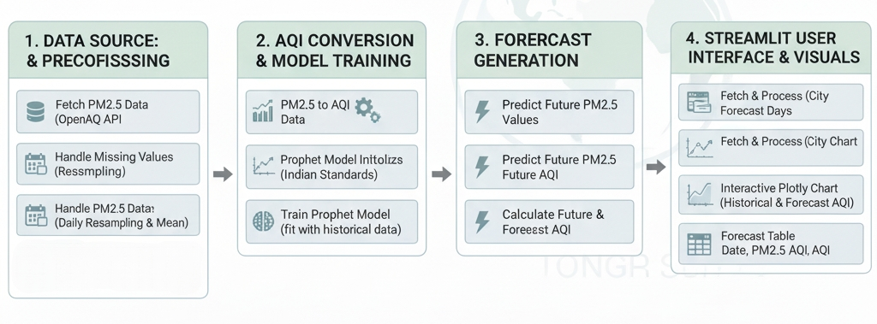
Modelling/Block Diagram/Flow of Project
Notes:
Sustainability and AI
Sustainability is important because it helps meet our needs now and in the future. It includes protecting the environment, reducing pollution, and improving economic and social well-being.
AI can help us achieve sustainability. AI can process data, make predictions, and optimize systems to solve problems like resource management, environmental conservation, and energy efficiency.
Examples:
Smart grids: Reduce energy consumption.
Agriculture: Optimize water and fertilizer use.
Biodiversity: Monitor wildlife to protect biodiversity.
AI is a powerful tool for creating a more sustainable future.

Slide 8
Result/Outcomes
Successfully predicts future AQI (Air Quality Index) levels for major Indian cities using Prophet time-series forecasting.
Displays interactive graphs and visual insights through a Streamlit dashboard.
Allows users to compare current and forecasted air quality trends.
Achieved accurate short-term predictions (next 7–30 days) based on PM2.5 data.
Helps users and authorities plan health measures and travel decisions based on predicted air pollution levels.
Provides a user-friendly web interface for real-time data visualization and forecast results.
Github link : https://github.com/HAMEEDVT/air-quality-forecasting
Notes:
Sustainability and AI
Sustainability is important because it helps meet our needs now and in the future. It includes protecting the environment, reducing pollution, and improving economic and social well-being.
AI can help us achieve sustainability. AI can process data, make predictions, and optimize systems to solve problems like resource management, environmental conservation, and energy efficiency.
Examples:
Smart grids: Reduce energy consumption.
Agriculture: Optimize water and fertilizer use.
Biodiversity: Monitor wildlife to protect biodiversity.
AI is a powerful tool for creating a more sustainable future.

Slide 9
Conclusion
This project demonstrates how Machine Learning can be applied to address real-world environmental challenges. By using the Prophet forecasting model and live air quality data, it accurately predicts future PM2.5 and AQI levels for Indian cities. The Streamlit dashboard makes these insights easy to understand and accessible to everyone. Overall, the system promotes awareness, data-driven decision-making, and proactive action toward improving air quality and public health.
Notes:
Sustainability and AI
Sustainability is important because it helps meet our needs now and in the future. It includes protecting the environment, reducing pollution, and improving economic and social well-being.
AI can help us achieve sustainability. AI can process data, make predictions, and optimize systems to solve problems like resource management, environmental conservation, and energy efficiency.
Examples:
Smart grids: Reduce energy consumption.
Agriculture: Optimize water and fertilizer use.
Biodiversity: Monitor wildlife to protect biodiversity.
AI is a powerful tool for creating a more sustainable future.

Slide 10
Future Perspective
Expand Data Sources: Integrate data from multiple APIs or government sensors for higher accuracy.
Add More Pollutants: Include parameters like PM10, CO₂, NO₂, SO₂, and O₃ for a complete AQI forecast.
Real-Time Alerts: Implement mobile or web notifications to warn users about poor air quality.
Machine Learning Enhancement: Upgrade to advanced models like LSTM or ARIMA for better long-term predictions.
Geographical Expansion: Cover more Indian cities and rural areas for broader environmental monitoring.
Integration with IoT Devices: Connect with local air quality sensors for live data collection and on-site forecasting.
Notes:
Sustainability and AI
Sustainability is important because it helps meet our needs now and in the future. It includes protecting the environment, reducing pollution, and improving economic and social well-being.
AI can help us achieve sustainability. AI can process data, make predictions, and optimize systems to solve problems like resource management, environmental conservation, and energy efficiency.
Examples:
Smart grids: Reduce energy consumption.
Agriculture: Optimize water and fertilizer use.
Biodiversity: Monitor wildlife to protect biodiversity.
AI is a powerful tool for creating a more sustainable future.

Slide 11
Thank You
Notes:
Thank You !!

